Slide 1
Statistical Inference
Nonparametric Statistical Tests

Slide 2
Contents
01
02
Understanding Nonparametric Tests
Mann-Whitney U Test
03
04
WiLcoxon’s Signed Rank Test
Kruskal Wallis Test
05
06
Chi Square Test of Association
Analysis of Variance

Slide 3
Understanding Nonparametric Tests
Parametric Assumptions
Distribution-Free Alternative
Power Considerations
Traditional tests based on t and F distributions assume that populations follow a normal distribution. When this assumption is violated, results may be unreliable.
When parametric assumptions are met, parametric tests have greater statistical power. However, nonparametric tests are more robust when assumptions are violated.
Nonparametric tests don't require assumptions about the population distribution. They're also called distribution-free tests and work with ordinal or non-normal continuous data.

Slide 4
Mann-Whitney U Test
Nonparametric Alternative to Independent t-Test
The Mann-Whitney U test compares differences between two independent groups when the dependent variable is either ordinal or continuous but not normally distributed. It's mathematically equivalent to the Wilcoxon rank-sum test.
01
02
Null Hypothesis
Alternative Hypothesis
The two samples come from the same population, meaning there's no difference in the distribution of values between groups.
The two samples come from different populations, indicating a significant difference exists between the groups.(stochastic superiority)

Slide 5



Mann-Whitney Test Procedure
Step-by-Step Calculation Process
Track Group Membership
Rank All Observations
Keep careful records of which group each ranked observation belongs to throughout the process.
Combine Samples
Arrange all values from smallest to largest and assign ranks from 1 to n.
Merge observations from both groups into a single dataset while maintaining group identity labels.
Important: Tied observations receive a rank equal to the mean of the rank positions they occupy. For example, if two values tie for ranks 5 and 6, both receive rank 5.5.

Slide 6
Computing the Test Statistic
Calculate U Statistic
Standardization
Decision Rule
The test statistic U is calculated using the formula that incorporates T (sum of ranks for the first sample), m (first sample size), and n (second sample size).
The standardized U statistic follows a normal distribution for moderate to large sample sizes, allowing use of z-tables for hypothesis testing.
Compare the calculated p-value with your predetermined level of significance (typically α = 0.05) to make your statistical conclusion.

Slide 7
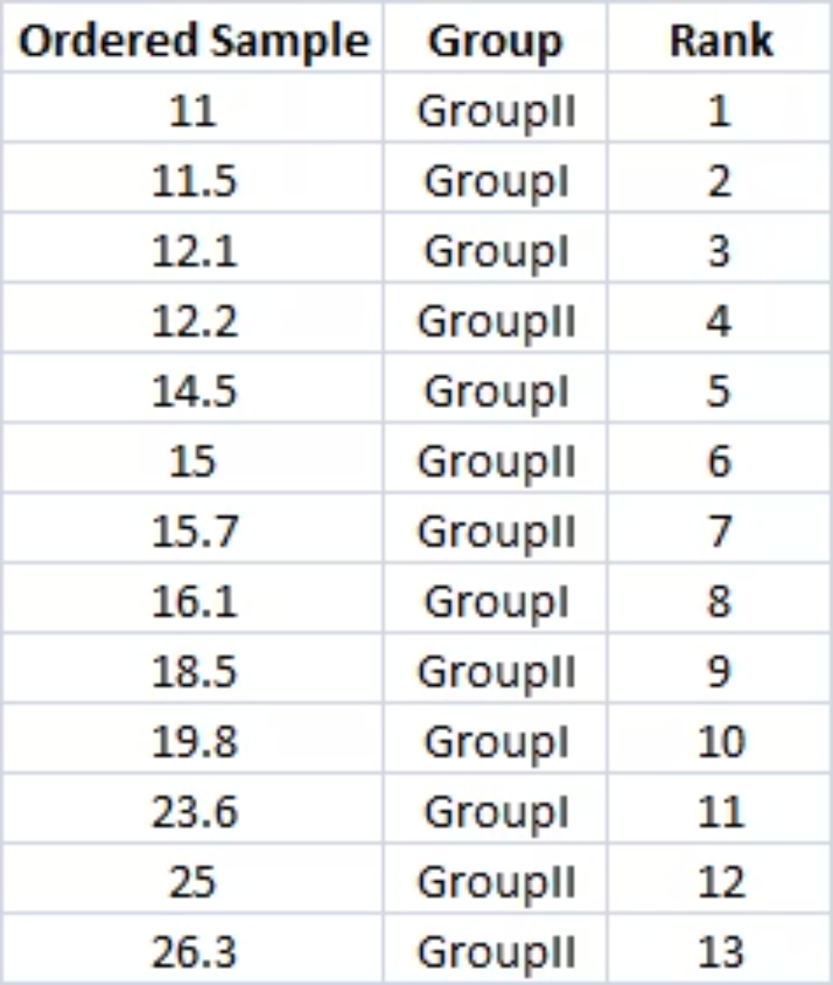
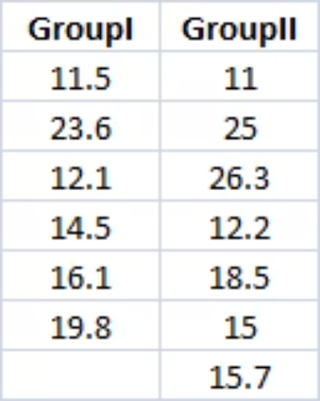
Mann-Whitney Test: Worked Example
Ranked Data
Sample Data
Two independent samples with different sizes
are combined and ranked.
39
6
7
T Value
m
n
Sum of ranks for first sample
First sample size
Second sample size

Slide 8



Example: Statistical Conclusion
Test Statistic
Expected Values
P-Value
U = 18
E(U) = 21
p = 0.7308
Calculated from the rank sums and sample sizes
V(U) = 49
Exact probability calculated in Python
software
Theoretical mean and variance under null hypothesis
Conclusion: Do Not Reject H₀
Since p-value (0.7308) exceeds the typical significance level of 0.05, we fail to reject the null hypothesis. There is insufficient evidence to conclude that the two samples come from different populations.

Slide 9



Application: Mobile Consumer Behaviour
Research Context
Understanding the factors that drive purchasing decisions among potential mobile phone customers is crucial for marketing strategy. One key factor under investigation is the importance consumers place on mobile phone color when making purchase decisions.
Measurement Scale
Feature: Color
Research Question
Consumer preferences measured using a 5-point Likert scale where 1 represents "Least Important" and 5 represents "Most Important."
Ratings indicate the level of importance given to color aesthetics in the mobile phone buying decision process.
Is there a statistically significant difference between the color importance ratings given by male and female customers?

Slide 10
Wilcoxon Signed Rank Test
Nonparametric Alternative to Paired t-Test
The Wilcoxon Signed Rank test is used to compare differences between two related or paired groups when the variable is either ordinal or continuous but not normally distributed. This test is ideal for before-after studies, matched pairs, or repeated measures designs.
Null Hypothesis
Alternative Hypothesis
The median of the differences in the population is zero, indicating no systematic change between paired observations. (assuming symmetry of paired differences)
The median of the differences is not zero, suggesting a significant change exists between the paired measurements.

Slide 11
Wilcoxon Signed Rank Test Procedure
Calculate Differences
1
Define Di = Xi - Yi, representing the difference between paired values for each observation.
Obtain Absolute Values
2
Calculate |Di|, the absolute value of each difference, removing the sign while preserving magnitude.
Rank Absolute Differences
3
Arrange all |Di| values from smallest to largest and assign ranks accordingly.
Assign Ranks
4
Define Ri as the rank of |Di|, maintaining connection to original observations.
Calculate Test Statistic
5
Obtain W, which is the sum of ranks associated with positive Di values only.

Slide 12
Computing the Wilcoxon Statistic
Test Statistic W
Normal Approximation
Statistical Decision
The W statistic equals the sum of ranks associated with positive differences. This captures the magnitude and direction of changes in the paired data.
For larger sample sizes (typically n ≥ 10), the standardized W statistic follows an approximate normal distribution, enabling use of z-scores and normal probability tables.
Compare the calculated p-value against your predetermined significance level (commonly α = 0.05) to determine whether to reject or fail to reject the null hypothesis.

Slide 13
Wilcoxon Test: Training Example
Scores Before and After Training Intervention
This example examines whether a training program produces significant changes in participant scores. Paired measurements are taken before and after the intervention to assess effectiveness.
4
W Statistic
Sum of ranks for positive differences
The test statistic W represents the sum of ranks associated with positive
differences (Di > 0), indicating participants who improved after training.
A small W value suggests most differences were negative, meaning scores
decreased after training.

Slide 14
Training Example: Results
Observed Statistic
Variance
W = 4
V(W) = 162.5
The sum of ranks for positive differences is notably small.
Measure of variability in the W statistic.
Expected Value
E(W) = 39
Under the null hypothesis, we would expect W to be approximately 39.
P-Value Analysis
Conclusion: Reject H₀
p = 0.001709
With p < 0.05, we reject the null hypothesis. Training produced a statistically significant change in scores.
One-tailed exact p-value indicates strong statistical significance

Slide 15



Application: Low Back Pain Patient's Assessment
Patient's assessment about pain level is measured twice: before treatment and after treatment. The patient's assessment is recorded on a 1-4 scale where 1 is no pain, 2 is mild pain, 3 is moderate pain, and 4 is severe pain.
Measurement Scale
Study Objective
1: No pain
Compare pain level before and after treatment to assess treatment effectiveness
2: Mild pain
3: Moderate pain
4: Severe pain
Before Treatment
Treatment Phase
After Treatment
Initial pain assessment recorded
Patient receives intervention
Follow-up pain assessment recorded

Slide 16
Kruskal-Wallis Test
Nonparametric Alternative to One-Way ANOVA
The Kruskal-Wallis test extends nonparametric comparison to three or more independent groups. It's used when the dependent variable is ordinal or continuous but doesn't meet normality assumptions required for traditional ANOVA.
When to Use
Null Hypothesis
Alternative Hypothesis
Apply this test when comparing multiple independent groups with ordinal or non-normal continuous data. It's particularly useful with small sample sizes or when normality cannot be assumed.
All k samples come from the same population, meaning no significant differences exist among the groups being compared.
At least one sample comes from a different population, indicating significant differences exist among the groups.

Slide 17




Kruskal-Wallis Test Procedure
Handle Tied Values
Combine and Rank
When multiple observations share the same value, assign each the mean of the ranks they occupy. For example, values tied at ranks 7, 8, and 9 each receive rank 8.
Merge all observations from k samples into a single dataset of size n. Arrange values in ascending order and assign ranks from 1 to n.
Compute H Statistic
Calculate Rank Sums
Calculate the test statistic H using the formula that incorporates rank sums and sample sizes. The H statistic follows a chi-square distribution with k-1 degrees of freedom.
Sum the ranks separately for each of the k groups to obtain k rank sums (R₁, R₂, ..., Rk).

Slide 18
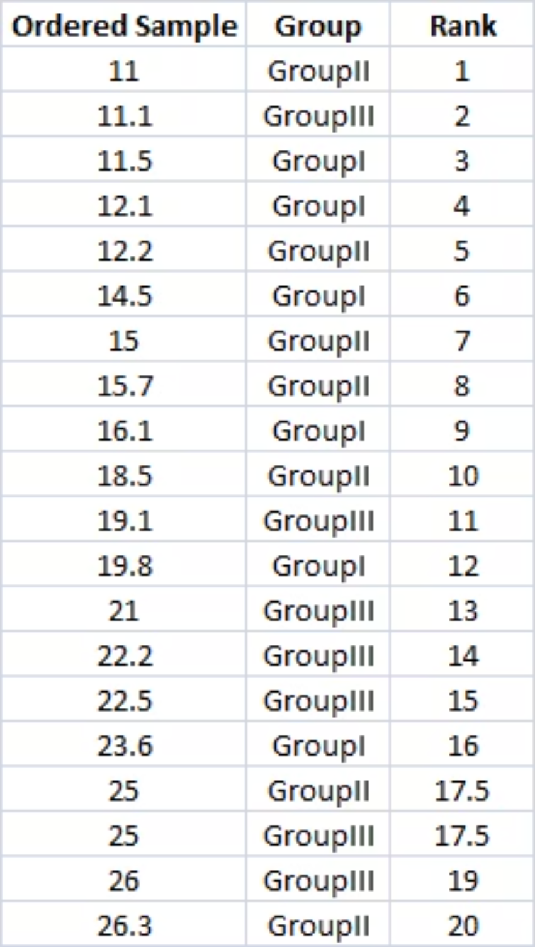
Kruskal-Wallis Test: Example
Sample Data and Rankings
Computed Values
Group 1
R₁ = 50, n₁ = 6
Group 2
R₂ = 68, n₂ = 7
Group 3
R₃ = 92, n₃ = 7
P-value = 0.3278
Since p > 0.05, we fail to reject H₀. No significant
difference exists among the three groups.

Slide 19



Application: Performance Appraisal Feedback
Employee Satisfaction Across Departments
A large organization seeks to evaluate employee satisfaction with their performance appraisal process. The HR manager wants to determine if satisfaction levels differ significantly across three key functional areas.
Marketing Department
Finance Department
IT Department
Employees involved in brand management, advertising, market research, and customer engagement initiatives.
Staff handling accounting, financial analysis, budgeting, auditing, and fiscal planning activities.
Technical professionals managing systems, software development, infrastructure, and technology support.
Measurement Scale: Employee feedback captured using a 5-point Likert scale ranging from 1 (Not satisfied at all) to 5 (Very satisfied) with the appraisal process.

Slide 20


Chi-Square Test of Independence
Testing Association Between Categorical Variables
The chi-square test for independence, also known as Pearson's chi-square test or the chi-square test of association, examines whether a relationship exists between two categorical variables. Both variables can be measured at the nominal or ordinal level.
Null Hypothesis
Alternative Hypothesis
The two categorical attributes are independent, meaning no association exists between them.
The attributes are not independent, indicating a significant association exists.
This test compares observed frequencies in a contingency table with expected frequencies calculated under the assumption of independence. Large discrepancies between observed and expected values provide evidence against the null hypothesis.

Slide 21
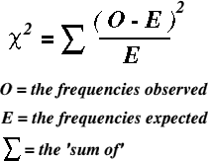
Chi-Square Test: Example
Comparing Observed and Expected Frequencies
Observed Frequencies
Expected Frequencies
The actual counts obtained from sample data, organized in a contingency table by row and column categories.
The frequencies we would expect if the null hypothesis of independence were true, calculated from marginal totals.
P value <0.05, Reject Ho. Recruitment Source and
Performance are associated.
Degrees of Freedom
df = (r - 1) × (c - 1)
Where r represents the number of rows and c represents the number of columns in the contingency table. The degrees of freedom determine the appropriate chi-square distribution for hypothesis testing.

Slide 22




Key Takeaways
Mann Whitney Test
Wilcoxon Signed Rank Test
To test whether two samples are drawn from the same
Population
Alternative to paired t test
Kruskal Wallis Test
Chi Square Test
To test whether K samples are drawn from the same
Population
To test the independence of two attributes

